Slide 1
COMPOSITE MATERIALS & STRUCTURES

Slide 2
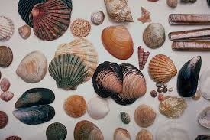
NATURALLY FOUND COMOSITES

Slide 3
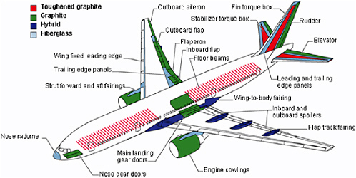
ADVANCED COMPOSITES

Slide 4
ADVANTAGES
High resistance to fatigue
High strength to stiffness ratio
High reliability
Achieve smooth aerodynamic profiles
Torsional stiffness
Dimensionally stable
Weatherability

Slide 5
DISADVANTAGES
High cost of raw materials
Matrix is weak & low toughness
Reuse & disposal may be difficult
Difficult to attach
greater difficulty in repairing them compared to metallic structures.
Temperature has an effect on composite mechanical properties.
mechanical properties decrease with increasing temperature.

Slide 6
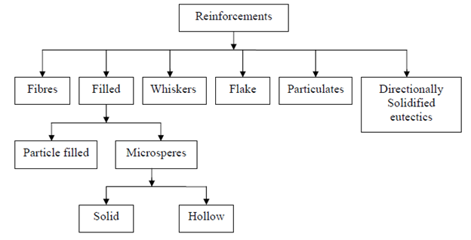
REINFORCEMENT

Slide 7
PARTICULATE
Particulate composites consists of particles immersed in matrices such as alloys & ceramics
They are usually isotropic because the particles are added randomly
Advantages : improved strength, increased operating temperature, oxidation resistance etc.
Examples : aluminum particles in rubber, silicon carbide particles in aluminum, & gravel, sand and cement to make concrete.

Slide 8
FLAKE
It consists of flat reinforcement of matrices.
Glass, mica, aluminum & silver.
Advantages : high out-of-plane flexural modulus, high strength, low cost.
Disadvantages : cannot be oriented easily & limited no. of materials for use.

Slide 9
FIBER
It consists of matrices reinforced by short (discontinuous) and long (continuous) fibers.
Fibers are anisotropic
Examples : carbon and aramids
CLASSIFICATIONS OF FIBERS
Glass fibers
Metal fibers
Alumina fibers
Boron fibers
Silicon carbide fibers
Aramid fibers
Quartz and silica fibers
Graphite fibers
Multiphase fibers

Slide 10
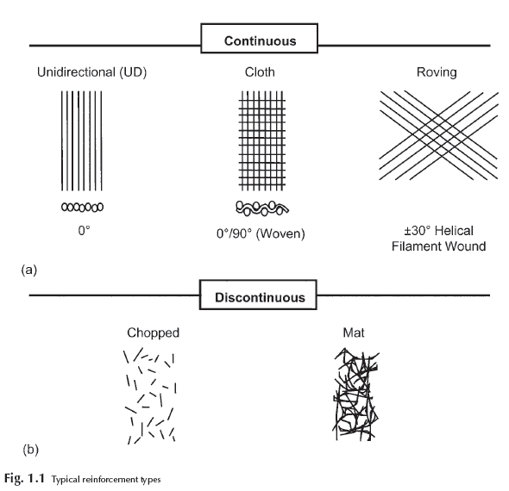

Slide 11
WHISKERS
Single crystals grown with nearly zero defects are termed whiskers.
They are usually discontinuous
Short fibers of different cross sections made from several materials like graphite, silicon carbide, copper, iron etc.
Typical lengths are in 3 to 55 N.M. ranges
Whiskers have a definite length to width ratio greater than one.
Extraordinary strengths upto 7000 MPa

Slide 12
NANOCOMPOSITES
It consist of materials that are of the scale of nanometers (10˄-9 m)
The accepted range to be classified at a nanocomposite is that one of the constituents is less than 100nm.
Advanced composite materials have microscale (10˄-6 m)
Applications : Packaging applications in military.
Toughness and impact strength can decrease.

Slide 13
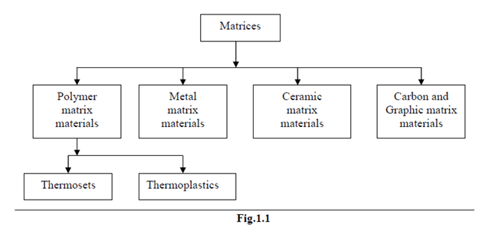
MATRICES

Slide 14
POLYMER MATRIX COMPOSITES
The most common advanced composites are PMC consisting of a polymer( e.g., graphite, polyester, urethane) reinforced by thin diameter fibers ( e.g., graphite, aramids, boron)
Graphite/epoxy composites are approximately 5 times stronger than steel.
Advantages : Low cost, high strength, simple fabrication principes.
Disadvantages : low operating temperature, high coefficients of thermal expansion, low elastic properties in certain directions.
Glass, graphite & Kevlar are most common fibers
Glass is the most common fiber used in PMC.
Advantages : high strength, low cost, high chemical resistance & good insulating properties
Disadvantages : low elastic modulus, low fatigue strength.

Slide 15
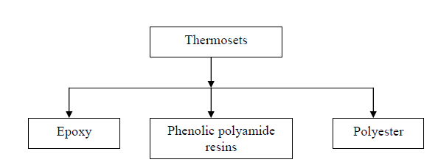
THERMOSETS

Slide 16
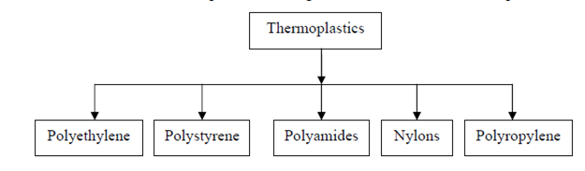
THERMOPLASTICS

Slide 17
DIFFERENCE
THERMOSET
THERMOPLASTIC
3-D molecular structure after curing
Insoluble & infusible after cure because the chains are rigidly joined with strong covalent bonds
Long cure cycles
Cannot be reprocessed
Low strain to failure
Epoxy, polyesters, phenolics & polymide
1-D or 2-D molecular structure after curing
It is formable at high temperature & pressure because the bonds are weak
short cure cycles
Can be reprocessed
High strain to failure
Polyethylene, polystyrene, polyether-ether-ketone (PEEK) & polyphenylene sulfide (PPS)

Slide 18
METAL MATRIX COMPOSITES
Metal matrix composites, at present though generating a wide interest in research fraternity, are not as widely in use as their plastic counterparts
High strength, fracture toughness and stiffness are offered by metal matrices than those offered by their polymer counterparts
Can withstand elevated temperature in corrosive environment than polymer composites
Most metals and alloys could be used as matrices and they require reinforcement materials which need to be stable over a range of temperature and non-reactive too.
Titanium, Aluminium and magnesium are the popular matrix metals currently in vogue, which are particularly useful for aircraft applications.
metallic matrix materials have to offer high strength, they require high modulus reinforcements
The strength-to-weight ratios of resulting composites can be higher than most alloys.

Slide 19
CERAMIC MATRIX COMPOSITES
Ceramics can be described as solid materials which exhibit very strong ionic bonding in general and in few cases covalent bonding.
High melting points, good corrosion resistance, stability at elevated temperatures and high compressive strength.
Ceramic matrices are the obvious choice for high temperature applications

Slide 20
CARBON MATRIX
Carbon and graphite have a special place in composite materials options, both being highly superior, high temperature materials with strengths and rigidity that are not affected by temperature up to 2300ºC.
Applications related to aeronautics, military, industry and space.

Slide 21
GLASS MATRIX
In comparison to ceramics and even considered on their own merit, glass matrices are found to be more reinforcement-friendly.
Glass matrix composite with high strength and modulus can be obtained and they can be maintained upto temperature of the order of 650ºC

Slide 22
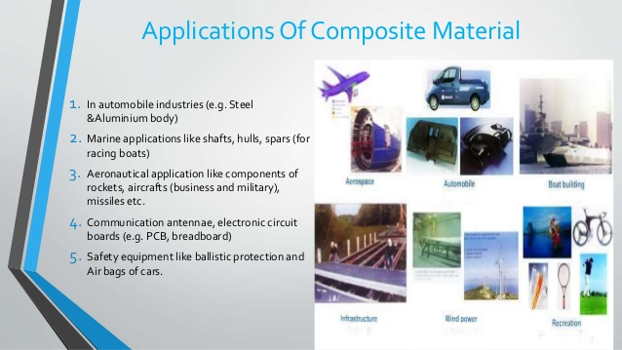
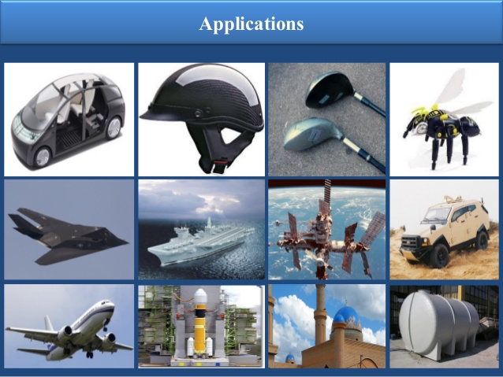
APPLICATIONS

